Slide 1

Analyze FitBit data for Marketing Strategy
Reinhard Shanahan Simba
18 February 2023

Slide 2
HELLO!
My name is Reinhard Shanahan Simba
My contacts:
Email: reinhardshenzl@gmail.com
LinkedIn: www.linkedin.com/in/reinhard-shanahan-simba-b13124284
GitHub: https://github.com/ReinhardShen

Slide 3
AGENDA
Background
Business Questions
Goals
Data
Key Findings
Suggestions
Things to Consider
Data Sources

Slide 4
Background
Bellabeat is a high-tech manufacturer of health-focused smart products for women since 2013.
Bellabeat has grown rapidly and quickly positioned itself as a tech-driven wellness company for females.
The Chief Creative Officer, Urška Sršen is confident that an analysis of non-Bellebeat consumer data (ie. FitBit fitness tracker usage data) would reveal more opportunities for growth.

Slide 5
Business questions
What are some trends in smart device usage?
How could these trends apply to Bellabeat customers?
How could these trends help influence Bellabeat marketing strategy?

Slide 6
goal
Analyze FitBit fitness tracker data to gain insights into how consumers are using the FitBit app and discover patterns for Bellabeat marketing strategy.

Slide 7
DATA SOURCE
Kaggle: FitBit Fitness Tracker Data: https://www.kaggle.com/datasets/arashnic/fitbit
Part of Google Data Analytics Professional Certificate
Betweeen 12 March 2016 to 11 April 2016
30 FitBit users who consented to the submission of personal tracker data.

Slide 8
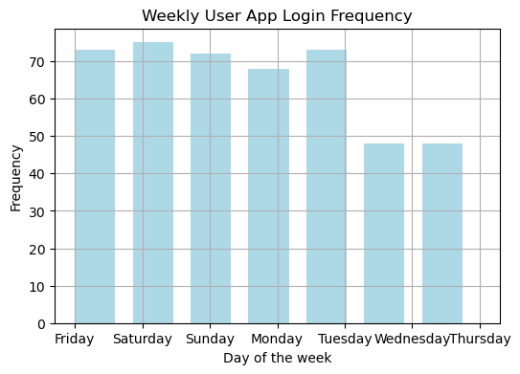
ANALYSIS - 1
Users mostly track their activity on the FitBit app from Friday to Tuesday
Noting that the frequency dropped on Wednesday and Thursday

Slide 9
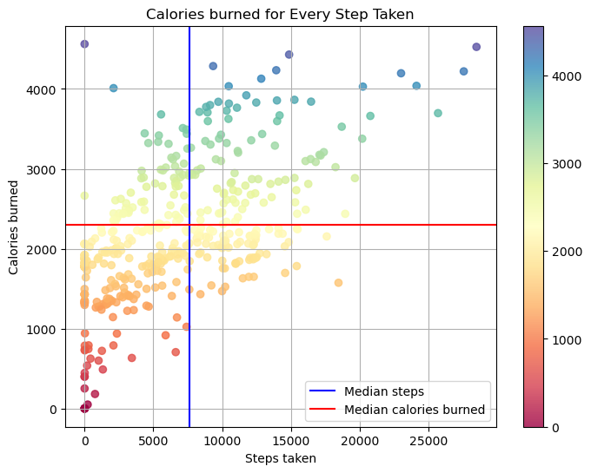
ANALYSIS - 2
Positive correlation observed between steps taken and calories burned up to 15,000 steps, after which calorie burn rate cools down.
Outliers: Zero steps led to minimal calorie burn, and one instance of 0 steps with over 4,000 calories burned.
Outliers attributed to natural variation, user behavior changes, or data collection errors such as miscalculations or contamination.

Slide 10
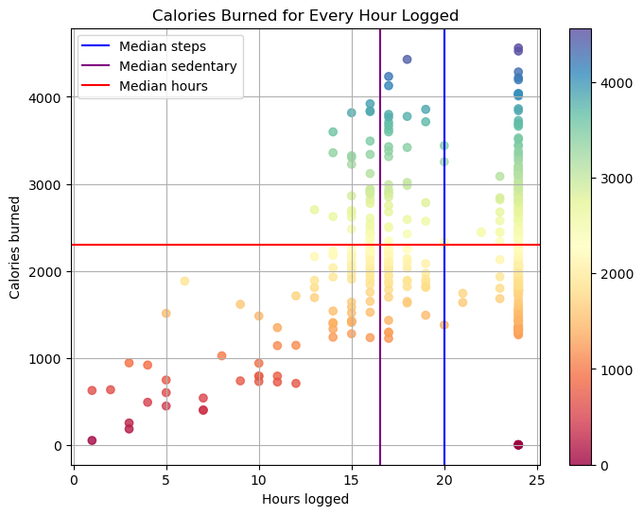
ANALYSIS - 3
Weak positive correlation observed: More logged hours don't equate to increased calories burned, mainly due to sedentary hours peaking around 16-17 hours.
Outliers noted:
Zero value outliers persist.
An anomalous red dot at 24 hours with zero calories burned, possibly for similar reasons as above.

Slide 11
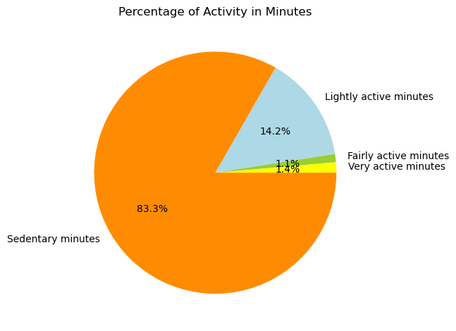
ANALYSIS - 4
Sedentary minutes takes the biggest slice at 83.3%
Users primarily use the FitBit app for daily activities such as commuting or running errands.
The app is rarely used for fitness tracking, with only 1.1% for fairly active and 1.4% for very active activities.

Slide 12

Findings & recommendations
Unlocking new horizons

Slide 13
Answer - 1
What are the trends identified?
Majority of users (83.3%) are using the FitBit app to track sedentary activities and not using it for tracking their health habits.
User engagement with the health tracker app declines on Wednesdays and Thursdays, possibly due to mid-week fatigue or routine disruption.

Slide 14

Answer - 2
How could these trends apply to Bellabeat customers?
Both companies innovate products centered on delivering women with their health, habit, and fitness data, empowering them to comprehend their existing behaviors and enact healthier choices, trends easily adaptable to Bellabeat’s customers.

Slide 15
Answer - 3
How could these trends help influence Bellabeat marketing strategy?
The marketing team can motivate users by informing and empowering them with insights about fitness advantages, recommending various workout options and providing details on calorie consumption and expenditure through the Bellabeat app.
Implement targeted motivational messages on Wednesdays and Thursdays within the app to support users in overcoming mid-week challenges and maintaining engagement with their health goals.

Slide 16
Thank you
Reinhard Shanahan Simba
reinhardshenzl@gmail.com

